Slide 1
COMP9414 Tutorial
Week 7

Slide 2

News
Assignment 1 submissions have closed
Was initially set to auto-submit
Check over your marks if you looked at them early
Plagiarism checking is currently happening
Hope you renamed those variables
Assignment 2 has been released
Due in week 9
Should have everything needed to complete it after this week

Slide 3
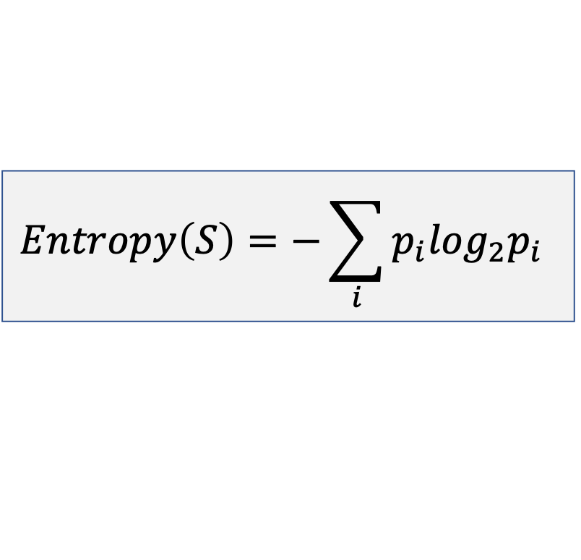
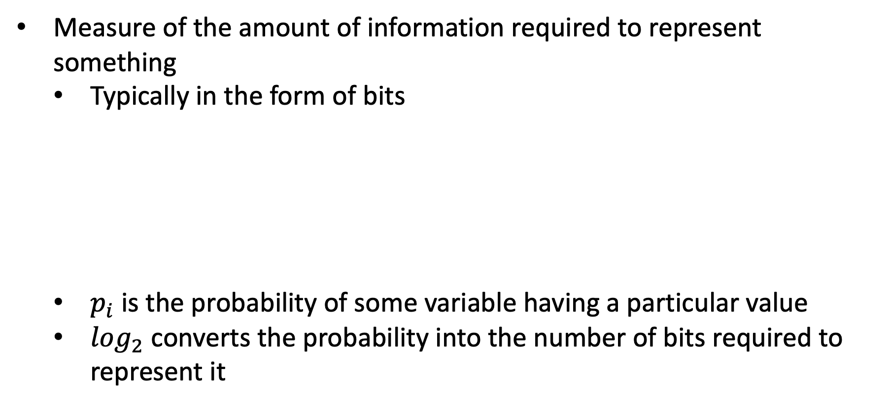
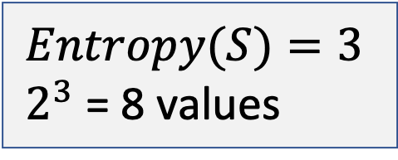
Background - Entropy
Measure of the amount of information required to represent something
Typically in the form of bits
$p_{i}$ is the probability of some variable having a particular value
$\log_{2}$ converts the probability into the number of bits required to represent it
Bits example
$$Entropy(S)=3$$
$2^{3}$ = 8 values
$$Entropy\left(S\right)=−\sum_{i}{p_{i}\log_{2}p_{i}}$$

Slide 4
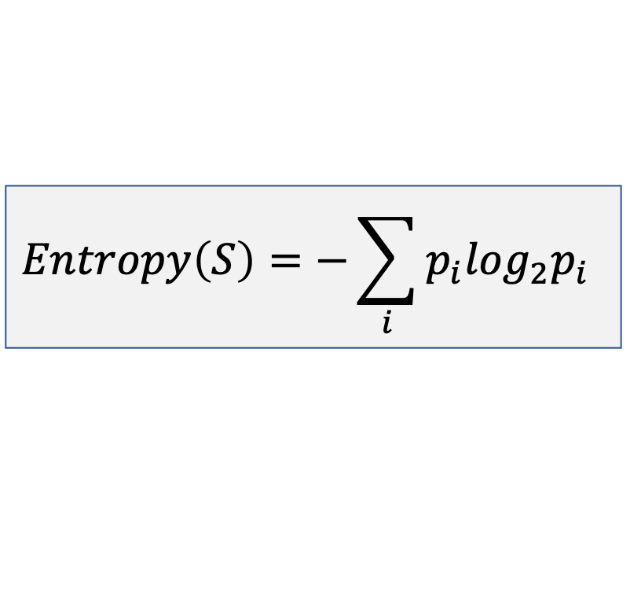
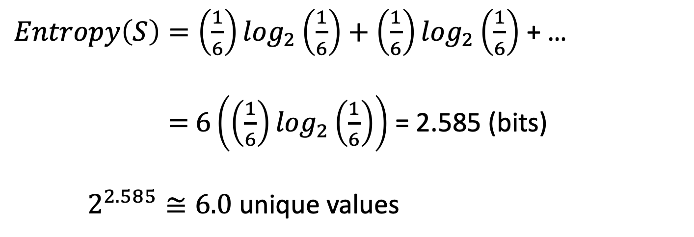
Background - Entropy (Dice Example)
$$Entropy\left(S\right)=−\sum_{i}{p_{i}\log_{2}p_{i}}$$
$Entropy\left(S\right)=\left(\frac{1}{6}\right)\log_{2}\left(\frac{1}{6}\right)+\left(\frac{1}{6}\right)\log_{2}\left(\frac{1}{6}\right)$ + …
$=$ $6\left(\left(\frac{1}{6}\right)\log_{2}\left(\frac{1}{6}\right)\right)$ = 2.585 (bits)
$2^{2.585}≅6.0$ unique values

Slide 5
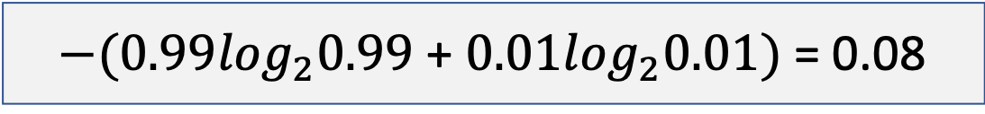

Background - Entropy (Coin Example)
Fair coin
50% heads
50% tails
Entropy of 1
1 bit required to store all information
Weighted coin
99% heads
1% tails
Entropy of 0.08
0.08 bits required to store all information
$−(0.5\log_{2}0.5$ + $0.5\log_{2}0.5)$ = 1.0
$−(0.99\log_{2}0.99$ + $0.01\log_{2}0.01)$ = 0.08

Slide 6
Background - Entropy (Shape Selection Example)
n(star) = n(green) + n(blue) = 2 + 7 = 9
If a shape is picked at random, will it be a star or a circle?
n(circle) = n(green) + n(blue) = 6 + 1 = 7

Slide 7
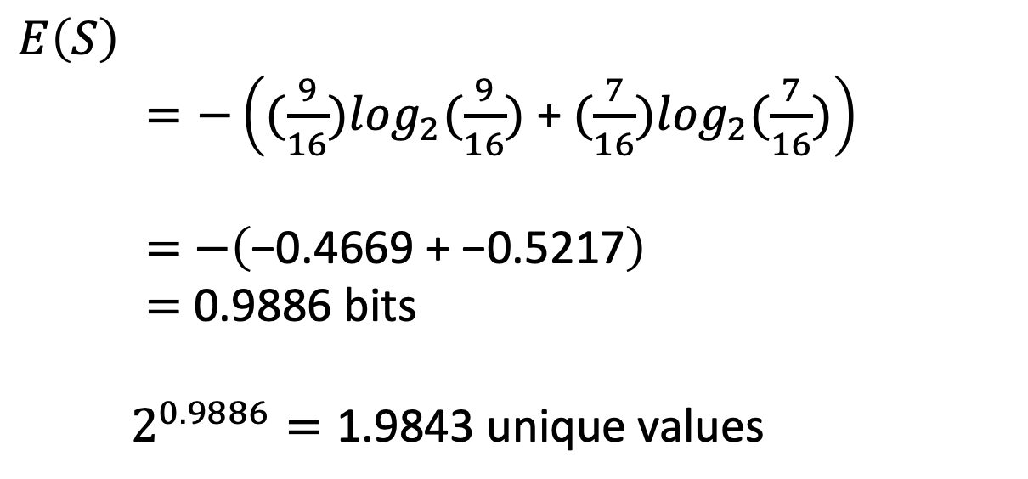
Background - Entropy (Shape Selection Example)
$$E\left(S\right)$$
$=−\left((\frac{9}{16})\log_{2}(\frac{9}{16})\text{ + }(\frac{7}{16})\log_{2}(\frac{7}{16})\right)$
$=$ $−\left(\text{−0.4669 }\text{+} \text{−0.5217}\right)$
$=$ 0.9886 bits
$2^{0.9886}=\text{1.984}\text{3 }\text{unique} \text{values}$

Slide 8
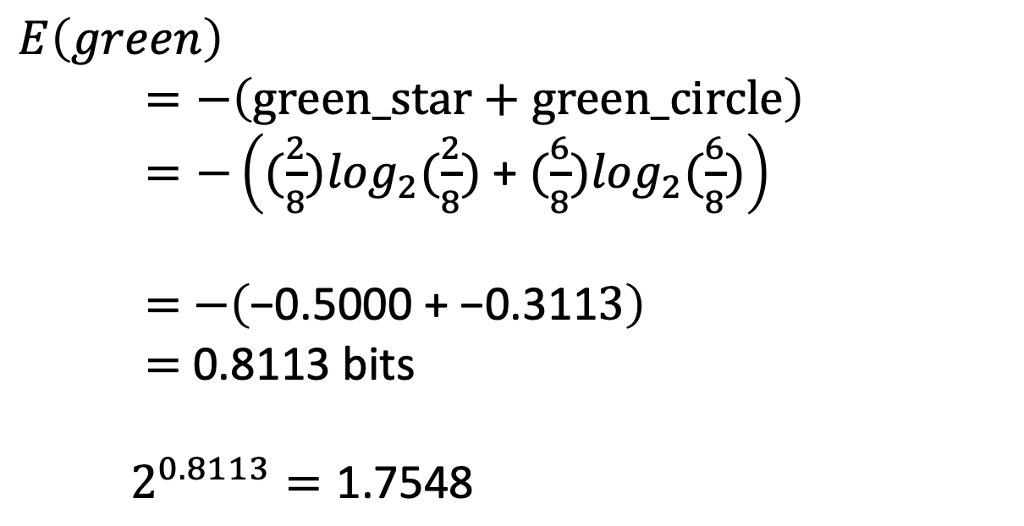
Background - Entropy (Shape Selection Example)
$$E\left(green\right)$$
$=−\left(\text{green}\text{_}\text{star}\text{ + }\text{green}\text{_}circle\right)$
$=−\left((\frac{2}{8})\log_{2}(\frac{2}{8})\text{ + }(\frac{6}{8})\log_{2}(\frac{6}{8})\right)$
$=$ $−\left(\text{−0.500}\text{0 }\text{+} \text{−0.311}3\right)$
$=$ 0.8113 bits
$2^{0.8113}=\text{1.754}\text{8}$

Slide 9
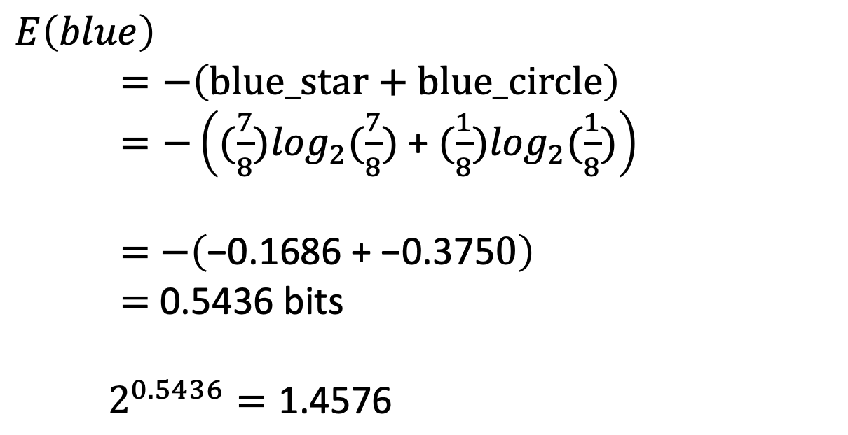
Background - Entropy (Shape Selection Example)
$$E\left(blue\right)$$
$=−\left(\text{blue}\text{_}\text{star}\text{ + }blue_circle\right)$
$=−\left((\frac{7}{8})\log_{2}(\frac{7}{8})\text{ + }(\frac{1}{8})\log_{2}(\frac{1}{8})\right)$
$=$ $−\left(\text{−0.1686 }\text{+} \text{−0.375}0\right)$
$=$ 0.5436 bits
$2^{0.5436}=\text{1.4576}$

Slide 10
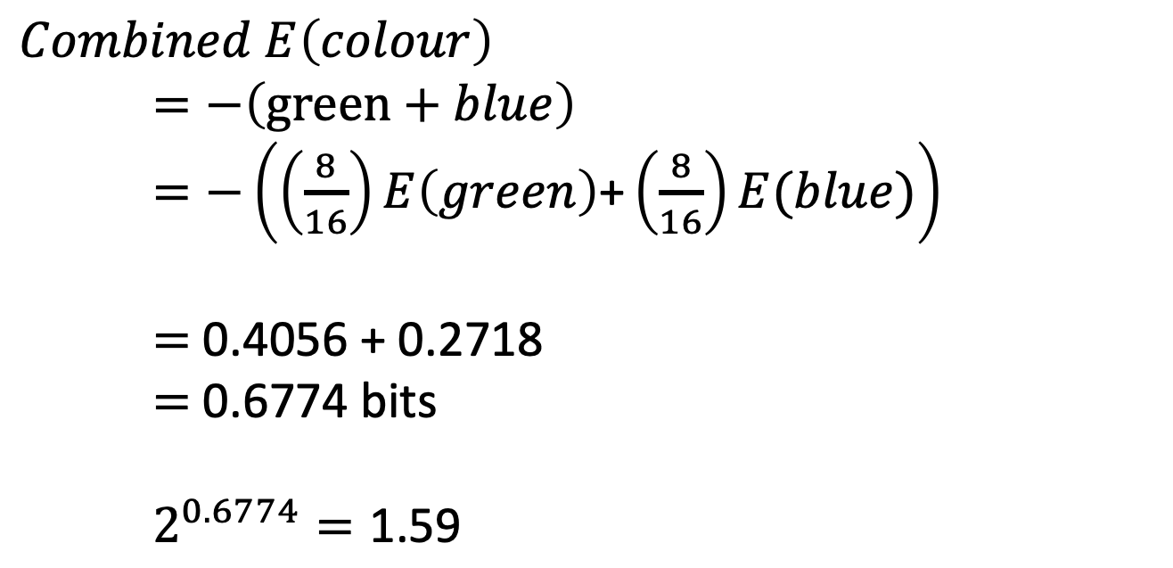
Background - Entropy (Shape Selection Example)
$$Combined E\left(colour\right)$$
$=−\left(\text{green}\text{ + }blue\right)$
$=−\left(\left(\frac{8}{16}\right)E\left(green\right)\text{+}\left(\frac{8}{16}\right)E(blue)\right)$
$=$ $\text{0.}\text{4056} \text{+ }\text{0.27}\text{18}$
$=$ 0.6774 bits
$2^{0.6774}=\text{1.5}\text{9}$

Slide 11
Entropy - Information Gain
Details how much information some properties tells you
High information gain is an informative property
High information gain properties should come first in decision trees
Splits the tree to a larger degree earlier
Resultant tree will be more succinct and compact

Slide 12
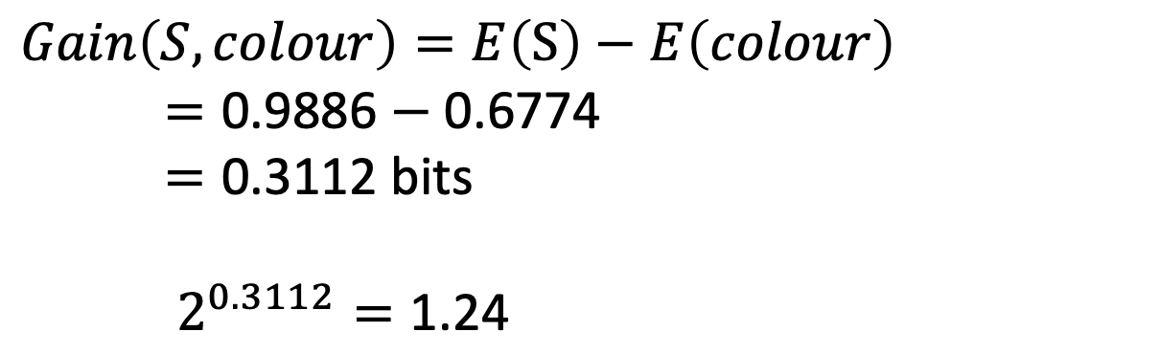
Background - Entropy (Shape Selection Example)
$$Gain\left(S, colour\right)=E\left(S\right)−E\left(colour\right)$$
$=\text{0.9886}−\text{0.67}\text{74}$
$=\text{0.3}\text{112}$ bits
$2^{0.3112}=\text{1.2}\text{4}$

Slide 13
Background - Entropy (Shape Selection Example)

Slide 14
Question 1
Day | Outlook | Temperature | Humidity | Wind | Play_tennis
D1 | Sunny | Hot | High | Weak | No
D2 | Sunny | Hot | High | Strong | No
D3 | Overcast | Hot | High | Weak | Yes
D4 | Rain | Mild | High | Weak | Yes
D5 | Rain | Cool | Normal | Weak | Yes
D6 | Rain | Cool | Normal | Strong | No
D7 | Overcast | Cool | Normal | Strong | Yes
D8 | Sunny | Mild | High | Weak | No
D9 | Sunny | Cool | Normal | Weak | Yes
D10 | Rain | Mild | Normal | Weak | Yes
D11 | Sunny | Mild | Normal | Strong | Yes
D12 | Overcast | Mild | High | Strong | Yes
D13 | Overcast | Hot | Normal | Weak | Yes
D14 | Rain | Mild | High | Strong | No

Slide 15
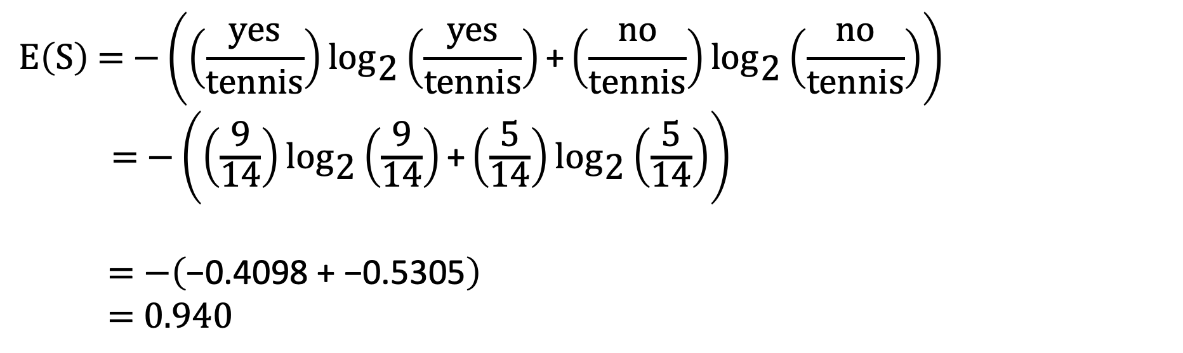
Question 1 – Parent Entropy
$$\text{E}\left(\text{S}\right) \text{= }\text{−}\left(\left(\frac{\text{yes}}{\text{tennis}}\right){\text{log}}_{\text{2}}\left(\frac{\text{yes}}{\text{tennis}}\right)\text{+}\left(\frac{\text{no}}{\text{tennis}}\right){\text{log}}_{\text{2}}\left(\frac{\text{no}}{\text{tennis}}\right)\right)$$
$\text{= −}\left(\left(\frac{\text{9}}{\text{14}}\right){\text{log}}_{\text{2}}\left(\frac{\text{9}}{\text{14}}\right)\text{+}\left(\frac{\text{5}}{\text{14}}\right){\text{log}}_{\text{2}}\left(\frac{\text{5}}{\text{14}}\right)\right)$
$$\text{=} \text{−}\left(\text{−0.4098 }\text{+} \text{−0.5305}\right)$$
$$\text{ =}\text{ 0.940}$$

Slide 16
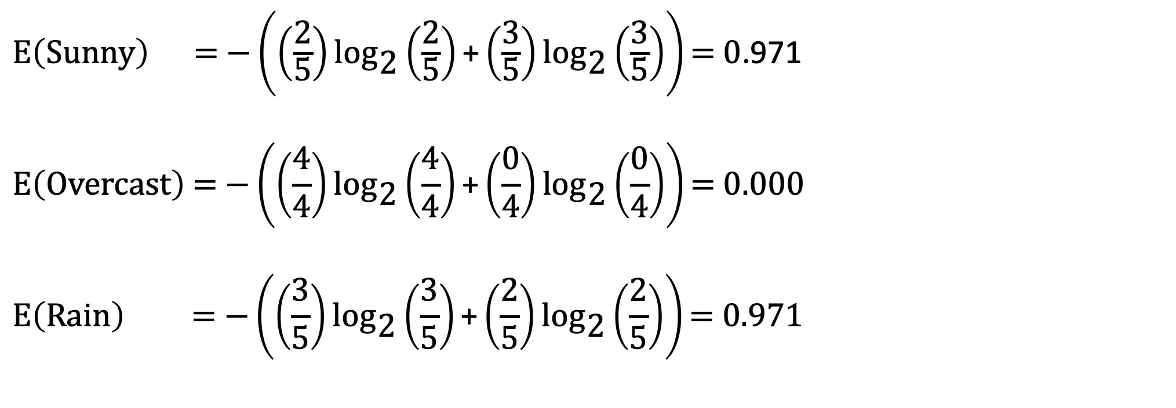
Question 1 – Outlook Entropy
$\text{E}\left(\text{Sunny}\right) \text{=} \text{−}\left(\left(\frac{\text{2}}{\text{5}}\right){\text{log}}_{\text{2}}\left(\frac{\text{2}}{\text{5}}\right)\text{+}\left(\frac{\text{3}}{\text{5}}\right){\text{log}}_{\text{2}}\left(\frac{\text{3}}{\text{5}}\right)\right)\text{=} \text{0}$.971
$$\text{E}\left(\text{Overcast}\right) \text{=} \text{−}\left(\left(\frac{\text{4}}{\text{4}}\right){\text{log}}_{\text{2}}\left(\frac{\text{4}}{\text{4}}\right)\text{+}\left(\frac{\text{0}}{\text{4}}\right){\text{log}}_{\text{2}}\left(\frac{\text{0}}{\text{4}}\right)\right)\text{=} \text{0}\text{.000}$$
$$\text{E}\left(\text{Rain}\right) \text{=} \text{−}\left(\left(\frac{\text{3}}{\text{5}}\right){\text{log}}_{\text{2}}\left(\frac{\text{3}}{\text{5}}\right)\text{+}\left(\frac{\text{2}}{\text{5}}\right){\text{log}}_{\text{2}}\left(\frac{\text{2}}{\text{5}}\right)\right)\text{=} \text{0.971}$$

Slide 17
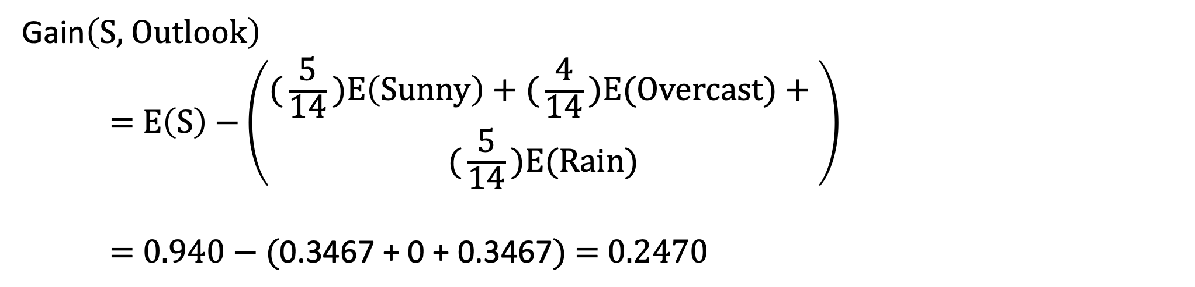
Question 1 – Outlook Entropy
Gain$\left(\text{S}\text{, }\text{Outlook}\right)$
$\text{=} \text{E}\left(\text{S}\right) \text{−}\left(\begin{aligned}\text{(}\frac{\text{5}}{\text{14}}\text{)}\text{E}\left(\text{Sunny}\right)\text{ + (}\frac{\text{4}}{\text{14}}\text{)}\text{E}\text{(}\text{Overcast}\text{) + } \\ \text{(}\frac{\text{5}}{\text{14}}\text{)}\text{E}\text{(}\text{Rain}\text{)}\end{aligned}\right)$
$\text{=}\text{ 0.940 }\text{−}\text{ (}\text{0.3467}\text{ + 0 + 0.3467}\text{)}\text{ = 0.2470}$

Slide 18
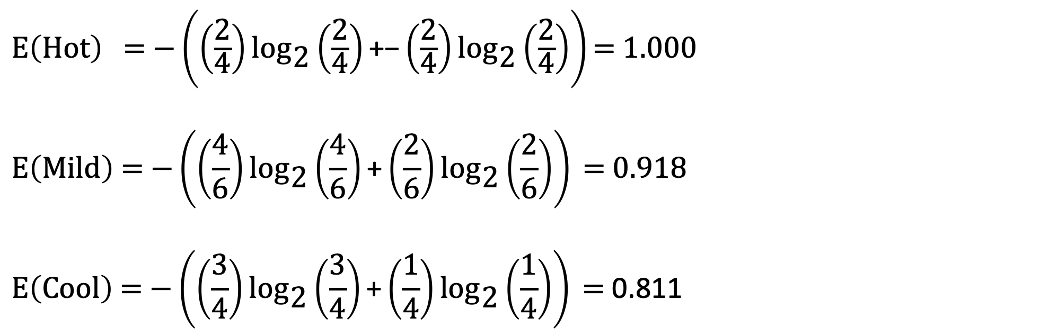
Question 1 – Temperature Entropy
$\text{E}\left(\text{Hot}\right)\text{ = −}\left(\left(\frac{\text{2}}{\text{4}}\right){\text{log}}_{\text{2}}\left(\frac{\text{2}}{\text{4}}\right)\text{+}\text{−}\left(\frac{\text{2}}{\text{4}}\right){\text{log}}_{\text{2}}\left(\frac{\text{2}}{\text{4}}\right)\right)\text{= 1.000 }$
$$\text{E}\left(\text{Mild}\right) \text{=} \text{−}\left(\left(\frac{\text{4}}{\text{6}}\right){\text{log}}_{\text{2}}\left(\frac{\text{4}}{\text{6}}\right)\text{+}\left(\frac{\text{2}}{\text{6}}\right){\text{log}}_{\text{2}}\left(\frac{\text{2}}{\text{6}}\right)\right) \text{=}\text{ 0.918}$$
$$\text{E}\left(\text{Cool}\right) \text{=} \text{−}\left(\left(\frac{\text{3}}{\text{4}}\right){\text{log}}_{\text{2}}\left(\frac{\text{3}}{\text{4}}\right)\text{+}\left(\frac{\text{1}}{\text{4}}\right){\text{log}}_{\text{2}}\left(\frac{\text{1}}{\text{4}}\right)\right) \text{=} \text{0.811}$$

Slide 19
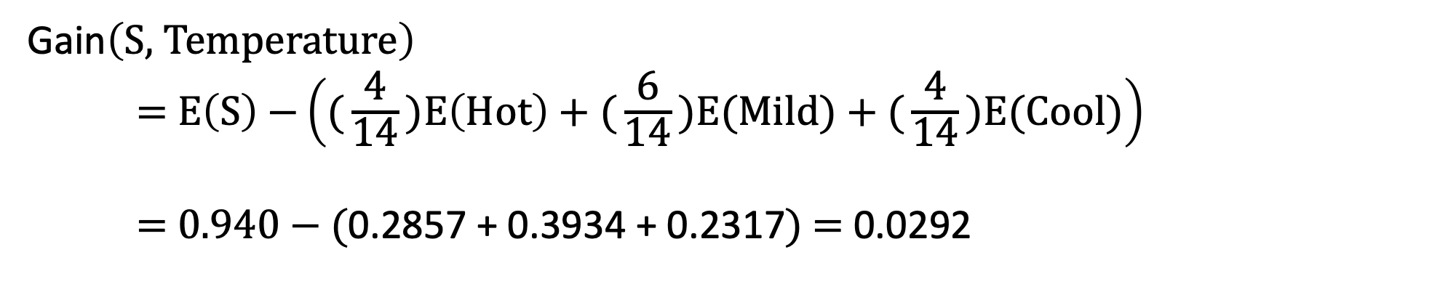
Question 1 – Temperature Entropy
Gain$\left(\text{S}\text{, }\text{Temperature}\right)$
$\text{=} \text{E}\left(\text{S}\right) \text{−}\left(\text{(}\frac{\text{4}}{\text{14}}\text{)}\text{E}\left(\text{Hot}\right) \text{+ (}\frac{\text{6}}{\text{14}}\text{)}\text{E}\text{(}\text{Mild}\text{) + (}\frac{\text{4}}{\text{14}}\text{)}\text{E}\text{(}\text{Cool}\text{)}\right)$
$\text{=}\text{ 0.940 }\text{−}\text{ (}\text{0.2857}\text{ + }\text{0.3934}\text{ + }\text{0.2317}\text{)}\text{ = }\text{0.0292}$

Slide 20
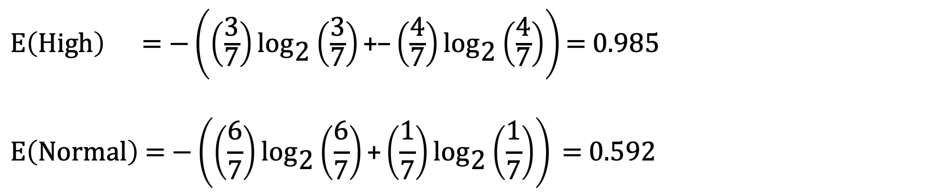
Question 1 – Humidity Entropy
$\text{E}\left(\text{High}\right)\text{ = −}\left(\left(\frac{\text{3}}{\text{7}}\right){\text{log}}_{\text{2}}\left(\frac{\text{3}}{\text{7}}\right)\text{+}\text{−}\left(\frac{\text{4}}{\text{7}}\right){\text{log}}_{\text{2}}\left(\frac{\text{4}}{\text{7}}\right)\right)\text{= 0.985 }$
$$\text{E}\left(\text{Normal}\right) \text{=} \text{−}\left(\left(\frac{\text{6}}{\text{7}}\right){\text{log}}_{\text{2}}\left(\frac{\text{6}}{\text{7}}\right)\text{+}\left(\frac{\text{1}}{\text{7}}\right){\text{log}}_{\text{2}}\left(\frac{\text{1}}{\text{7}}\right)\right) \text{=}\text{ 0.592}$$

Slide 21
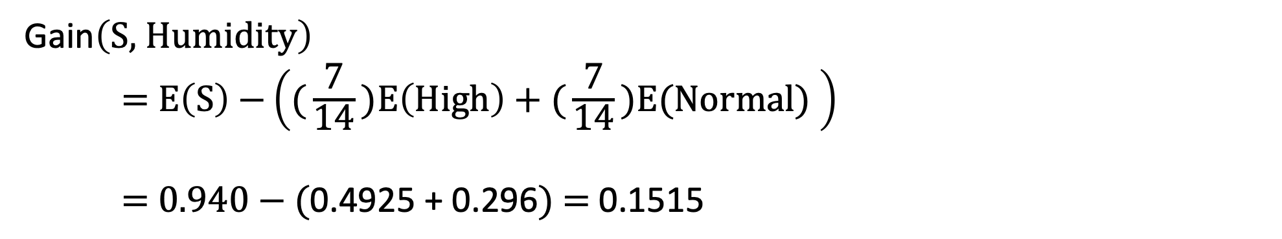
Question 1 – Humidity Entropy
Gain$\left(\text{S}\text{, }\text{Humidity}\right)$
$\text{=} \text{E}\left(\text{S}\right) \text{−}\left(\text{(}\frac{\text{7}}{\text{14}}\text{)}\text{E}\left(\text{High}\right)\text{ + (}\frac{\text{7}}{\text{14}}\text{)}\text{E}\text{(}\text{Normal}\text{) }\right)$
$\text{=}\text{ 0.940 }\text{−}\text{ (}\text{0.4925}\text{ + }\text{0.296}\text{)}\text{ = }\text{0.1515}$

Slide 22
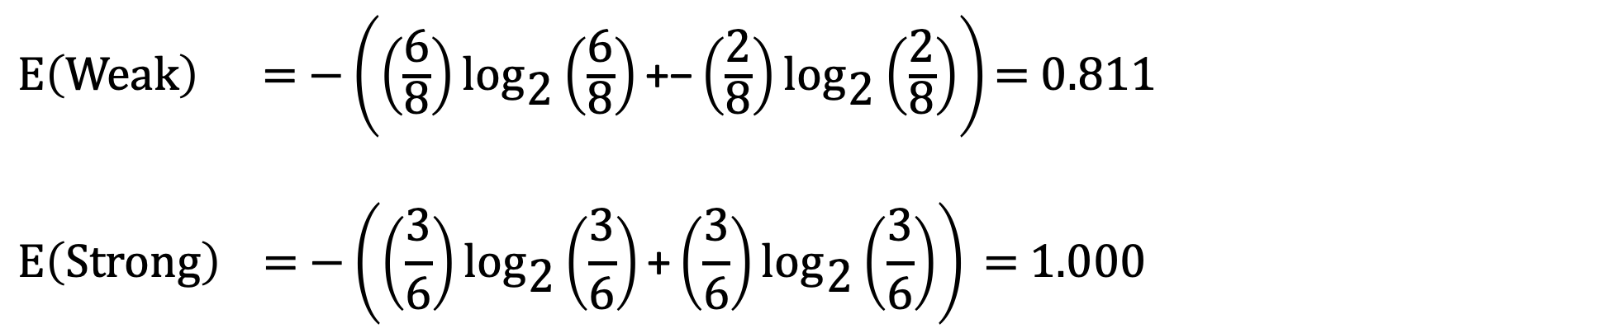
Question 1 – Wind Entropy
$\text{E}\left(\text{Weak}\right)\text{ = −}\left(\left(\frac{\text{6}}{\text{8}}\right){\text{log}}_{\text{2}}\left(\frac{\text{6}}{\text{8}}\right)\text{+}\text{−}\left(\frac{\text{2}}{\text{8}}\right){\text{log}}_{\text{2}}\left(\frac{\text{2}}{\text{8}}\right)\right)\text{= 0.811 }$
$$\text{E}\left(\text{Strong}\right) \text{=} \text{−}\left(\left(\frac{\text{3}}{\text{6}}\right){\text{log}}_{\text{2}}\left(\frac{\text{3}}{\text{6}}\right)\text{+}\left(\frac{\text{3}}{\text{6}}\right){\text{log}}_{\text{2}}\left(\frac{\text{3}}{\text{6}}\right)\right) \text{=}\text{ 1.000}$$

Slide 23
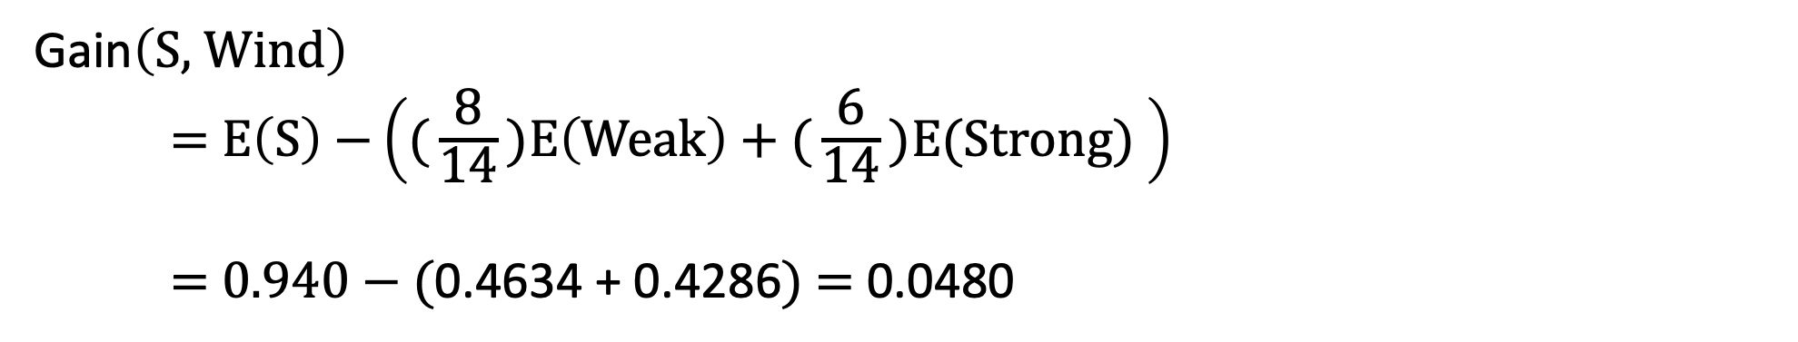
Question 1 – Wind Entropy
Gain$\left(\text{S}\text{, }\text{Wind}\right)$
$\text{=} \text{E}\left(\text{S}\right) \text{−}\left(\text{(}\frac{\text{8}}{\text{14}}\text{)}\text{E}\left(\text{Weak}\right)\text{ + (}\frac{\text{6}}{\text{14}}\text{)}\text{E}\text{(}\text{Strong}\text{) }\right)$
$\text{=}\text{ 0.940 }\text{−}\text{ (}\text{0.4634}\text{ + }\text{0.4286}\text{)}\text{ = }\text{0.048}$0

Slide 24
Question 1 – First Feature Selection Gains
Gain(S, Outlook) = 0.2470
Gain(S, Temperature) = 0.0292
Gain(S, Humidity) = 0.1515
Gain(S, Wind) = 0.0480
Split based on Outlook

Slide 25
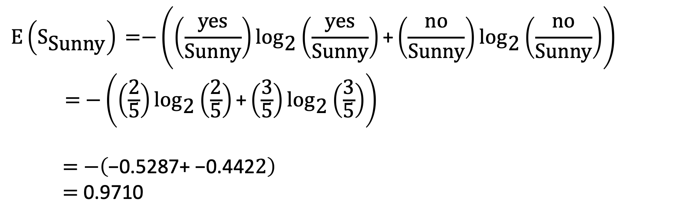
Question 1 – Sunny Outlook Entropy
$$\text{E}\left({\text{S}}_{\text{Sunny}}\right) \text{=}\text{−}\left(\left(\frac{\text{yes}}{\text{Sunny}}\right){\text{log}}_{\text{2}}\left(\frac{\text{yes}}{\text{Sunny}}\right)\text{+}\left(\frac{\text{no}}{\text{Sunny}}\right){\text{log}}_{\text{2}}\left(\frac{\text{no}}{\text{Sunny}}\right)\right)$$
$\text{= −}\left(\left(\frac{\text{2}}{\text{5}}\right){\text{log}}_{\text{2}}\left(\frac{\text{2}}{\text{5}}\right)\text{+}\left(\frac{\text{3}}{\text{5}}\right){\text{log}}_{\text{2}}\left(\frac{\text{3}}{\text{5}}\right)\right)$
$$\text{=} \text{−}\left(\text{−0.5287}\text{+} \text{−0.4422}\right)$$
$$\text{ =} \text{0.9710}$$

Slide 26
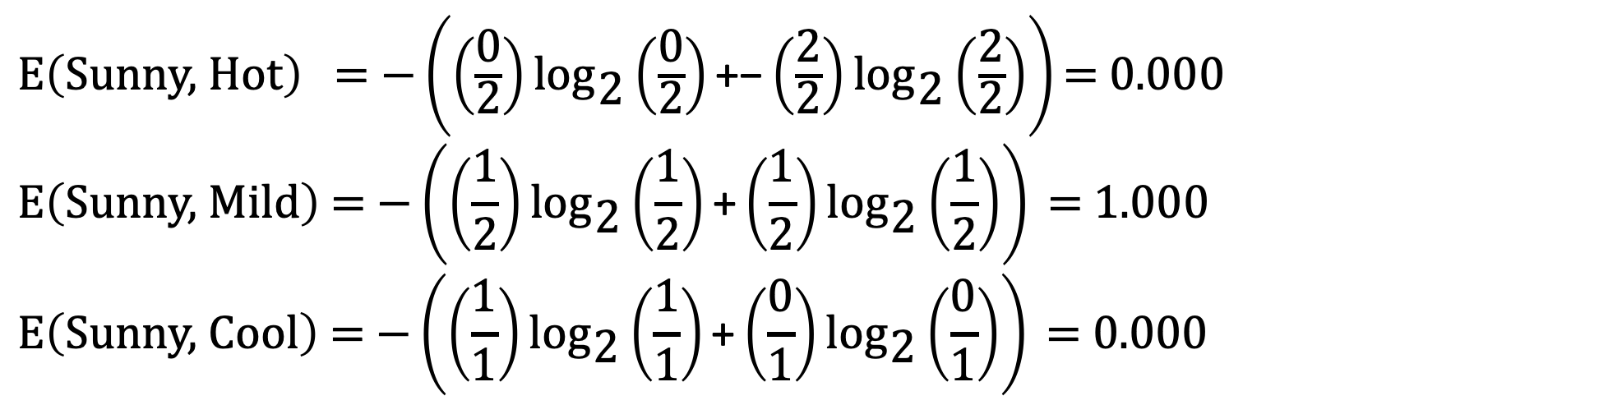
Question 1 – Temperature Entropy given Sunny
$\text{E}\left(\text{Sunny}\text{, }\text{Hot}\right)\text{ = −}\left(\left(\frac{\text{0}}{\text{2}}\right){\text{log}}_{\text{2}}\left(\frac{\text{0}}{\text{2}}\right)\text{+}\text{−}\left(\frac{\text{2}}{\text{2}}\right){\text{log}}_{\text{2}}\left(\frac{\text{2}}{\text{2}}\right)\right)\text{= 0.000 }$
$$\text{E}\left(\text{Sunny}\text{, }\text{Mild}\right) \text{=} \text{−}\left(\left(\frac{\text{1}}{\text{2}}\right){\text{log}}_{\text{2}}\left(\frac{\text{1}}{\text{2}}\right)\text{+}\left(\frac{\text{1}}{\text{2}}\right){\text{log}}_{\text{2}}\left(\frac{\text{1}}{\text{2}}\right)\right) \text{=}\text{ 1.000}$$
$$\text{E}\left(\text{Sunny}\text{, }\text{Cool}\right) \text{=} \text{−}\left(\left(\frac{\text{1}}{\text{1}}\right){\text{log}}_{\text{2}}\left(\frac{\text{1}}{\text{1}}\right)\text{+}\left(\frac{\text{0}}{\text{1}}\right){\text{log}}_{\text{2}}\left(\frac{\text{0}}{\text{1}}\right)\right) \text{=}\text{ 0.000}$$

Slide 27
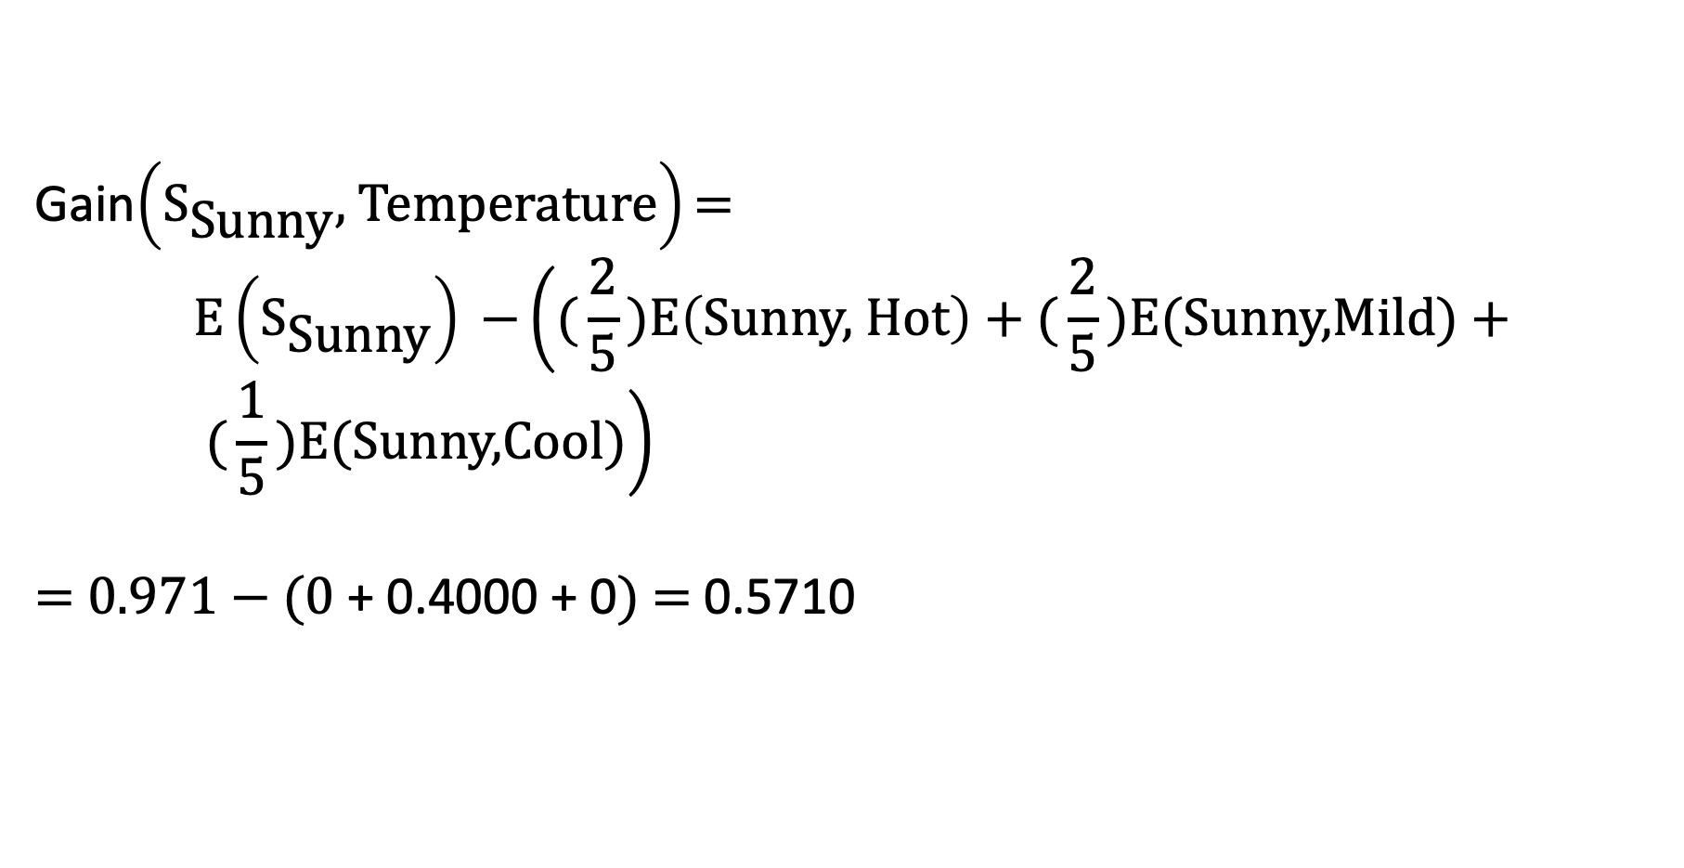
Question 1 – Temperature Entropy given Sunny
Gain$\left({\text{S}}_{\text{Sunny}}\text{, }\text{Temperature}\right)\text{=}$
$$\text{E}\left({\text{S}}_{\text{Sunny}}\right) \text{−}\left(\text{(}\frac{\text{2}}{\text{5}}\text{)}\text{E}\left(\text{Sunny}\text{, }\text{Hot}\right)\text{ + (}\frac{\text{2}}{\text{5}}\text{)}\text{E}\text{(}\text{Sunny}\text{,}\text{Mild}\text{) + (}\frac{\text{1}}{\text{5}}\text{)}\text{E}\text{(}\text{Sunny}\text{,}\text{Cool}\text{)}\right)$$
$\text{=}\text{ 0.971 }\text{−}\text{ (0}\text{ + }\text{0.4}\text{000 + 0}\text{)}\text{ = }\text{0.571}$0

Slide 28
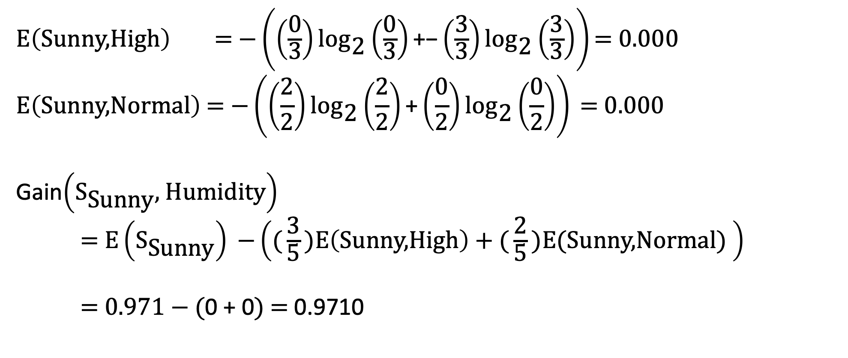
Question 1 – Humidity Entropy given Sunny
$\text{E}\left(\text{Sunny}\text{,}\text{High}\right)\text{ = −}\left(\left(\frac{\text{0}}{\text{3}}\right){\text{log}}_{\text{2}}\left(\frac{\text{0}}{\text{3}}\right)\text{+}\text{−}\left(\frac{\text{3}}{\text{3}}\right){\text{log}}_{\text{2}}\left(\frac{\text{3}}{\text{3}}\right)\right)\text{= 0.000 }$
$$\text{E}\left(\text{Sunny}\text{,}\text{Normal}\right) \text{=} \text{−}\left(\left(\frac{\text{2}}{\text{2}}\right){\text{log}}_{\text{2}}\left(\frac{\text{2}}{\text{2}}\right)\text{+}\left(\frac{\text{0}}{\text{2}}\right){\text{log}}_{\text{2}}\left(\frac{\text{0}}{\text{2}}\right)\right) \text{=}\text{ 0.000}$$
Gain$\left({\text{S}}_{\text{Sunny}}\text{, }\text{Humidity}\right)$
$\text{=} \text{E}\left({\text{S}}_{\text{Sunny}}\right) \text{−}\left(\text{(}\frac{\text{3}}{\text{5}}\text{)}\text{E}\left(\text{Sunny}\text{,}\text{High}\right)\text{ + (}\frac{\text{2}}{\text{5}}\text{)}\text{E}\text{(}\text{Sunny}\text{,}\text{Normal}\text{) }\right)$
$\text{=}\text{ 0.971 }\text{−}\text{ (}\text{0}\text{ + }\text{0}\text{)}\text{ = }\text{0.9710}$

Slide 29
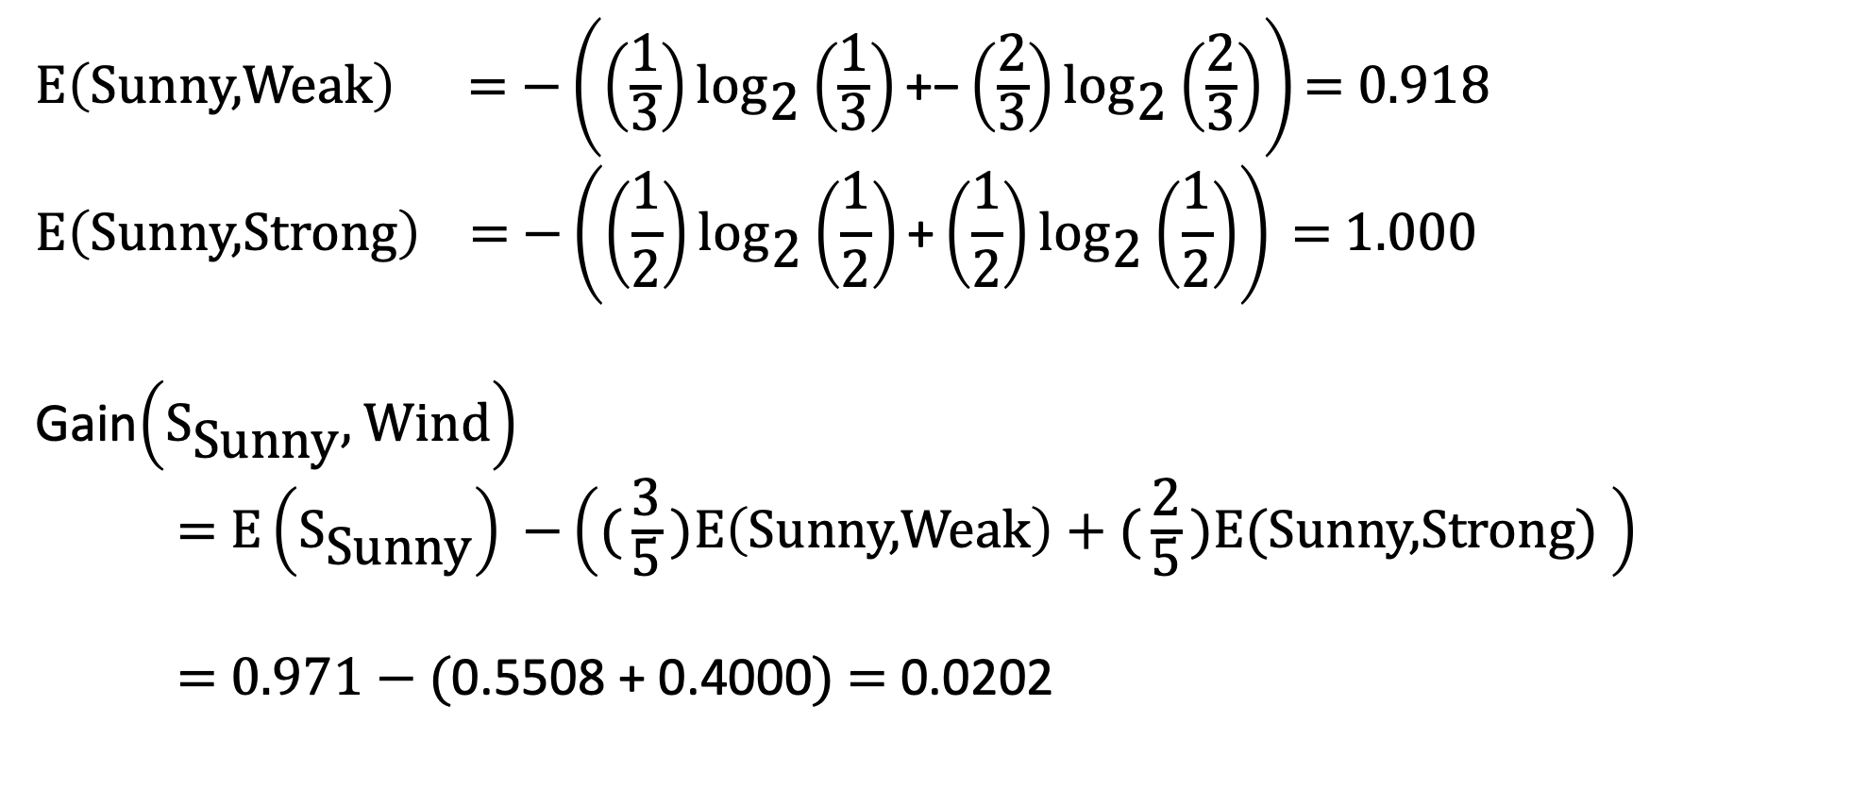
Question 1 – Wind Entropy given Sunny
$\text{E}\left(\text{Sunny}\text{,}\text{Weak}\right)\text{ = −}\left(\left(\frac{\text{1}}{\text{3}}\right){\text{log}}_{\text{2}}\left(\frac{\text{1}}{\text{3}}\right)\text{+}\text{−}\left(\frac{\text{2}}{\text{3}}\right){\text{log}}_{\text{2}}\left(\frac{\text{2}}{\text{3}}\right)\right)\text{= 0.918 }$
$$\text{E}\left(\text{Sunny}\text{,}\text{Strong}\right) \text{=} \text{−}\left(\left(\frac{\text{1}}{\text{2}}\right){\text{log}}_{\text{2}}\left(\frac{\text{1}}{\text{2}}\right)\text{+}\left(\frac{\text{1}}{\text{2}}\right){\text{log}}_{\text{2}}\left(\frac{\text{1}}{\text{2}}\right)\right) \text{=}\text{ 1.000}$$
Gain$\left({\text{S}}_{\text{Sunny}}\text{, }\text{Wind}\right)$
$\text{=} \text{E}\left({\text{S}}_{\text{Sunny}}\right) \text{−}\left(\text{(}\frac{\text{3}}{\text{5}}\text{)}\text{E}\left(\text{Sunny}\text{,}\text{Weak}\right)\text{ + (}\frac{\text{2}}{\text{5}}\text{)}\text{E}\text{(}\text{Sunny}\text{,}\text{Strong}\text{) }\right)$
$\text{=}\text{ 0.971 }\text{−}\text{ (}\text{0.5508}\text{ + }\text{0.4000}\text{)}\text{ = }\text{0.0202}$

Slide 30
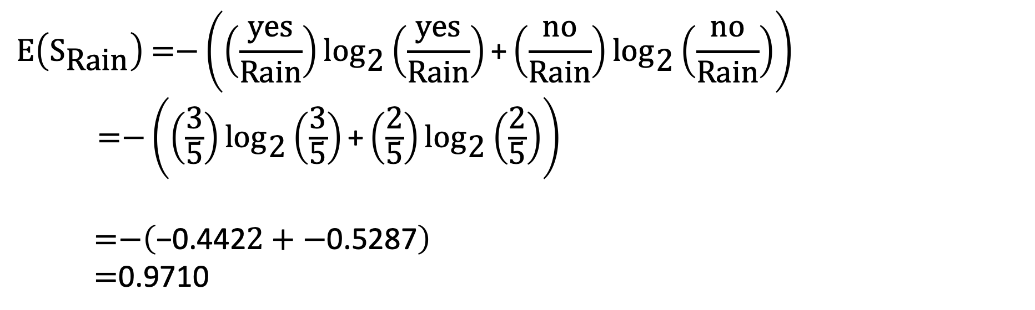
Question 1 – Rain Outlook Entropy
$$\text{E}\left({\text{S}}_{\text{Rain}}\right) \text{=}\text{−}\left(\left(\frac{\text{yes}}{\text{Rain}}\right){\text{log}}_{\text{2}}\left(\frac{\text{yes}}{\text{Rain}}\right)\text{+}\left(\frac{\text{no}}{\text{Rain}}\right){\text{log}}_{\text{2}}\left(\frac{\text{no}}{\text{Rain}}\right)\right)$$
$\text{=−}\left(\left(\frac{\text{3}}{\text{5}}\right){\text{log}}_{\text{2}}\left(\frac{\text{3}}{\text{5}}\right)\text{+}\left(\frac{\text{2}}{\text{5}}\right){\text{log}}_{\text{2}}\left(\frac{\text{2}}{\text{5}}\right)\right)$
$$\text{=−}\left(\text{−0.4422 }\text{+ −}\text{0.5287}\right)$$
$$\text{ =}\text{0.9710}$$

Slide 31
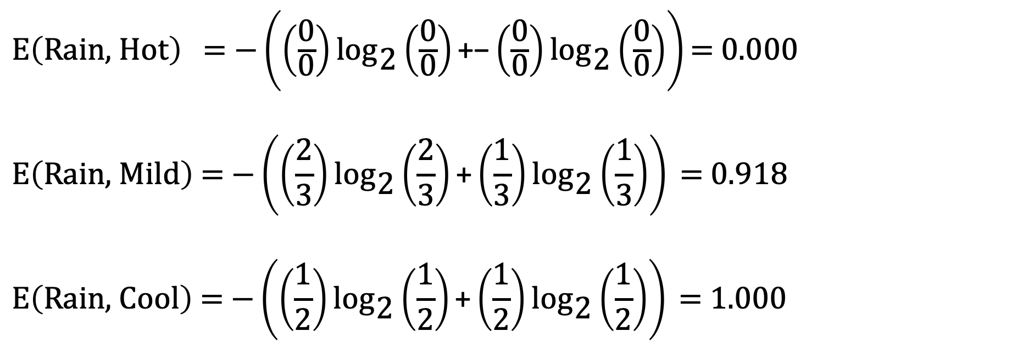
Question 1 – Temperature Entropy given Rain
$\text{E}\left(\text{Rain}\text{, }\text{Hot}\right)\text{ = −}\left(\left(\frac{\text{0}}{\text{0}}\right){\text{log}}_{\text{2}}\left(\frac{\text{0}}{\text{0}}\right)\text{+}\text{−}\left(\frac{\text{0}}{\text{0}}\right){\text{log}}_{\text{2}}\left(\frac{\text{0}}{\text{0}}\right)\right)\text{= 0.000 }$
$$\text{E}\left(\text{Rain}\text{, }\text{Mild}\right) \text{=} \text{−}\left(\left(\frac{\text{2}}{\text{3}}\right){\text{log}}_{\text{2}}\left(\frac{\text{2}}{\text{3}}\right)\text{+}\left(\frac{\text{1}}{\text{3}}\right){\text{log}}_{\text{2}}\left(\frac{\text{1}}{\text{3}}\right)\right) \text{=}\text{ 0.918}$$
$$\text{E}\left(\text{Rain}\text{, }\text{Cool}\right) \text{=} \text{−}\left(\left(\frac{\text{1}}{\text{2}}\right){\text{log}}_{\text{2}}\left(\frac{\text{1}}{\text{2}}\right)\text{+}\left(\frac{\text{1}}{\text{2}}\right){\text{log}}_{\text{2}}\left(\frac{\text{1}}{\text{2}}\right)\right) \text{=}\text{ 1.000}$$

Slide 32
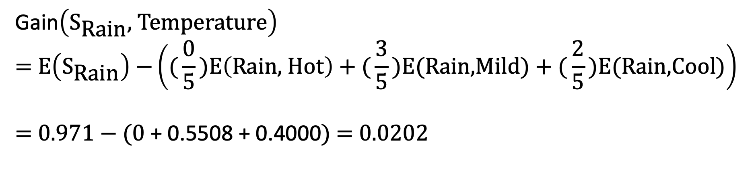
Question 1 – Temperature Entropy given Rain
Gain$\left({\text{S}}_{\text{Rain}}\text{, }\text{Temperature}\right)$
$$\text{=} \text{E}\left({\text{S}}_{\text{Rain}}\right) \text{−}\left(\text{(}\frac{\text{0}}{\text{5}}\text{)}\text{E}\left(\text{Rain}\text{, }\text{Hot}\right)\text{ + (}\frac{\text{3}}{\text{5}}\text{)}\text{E}\text{(}\text{Rain}\text{,}\text{Mild}\text{) + (}\frac{\text{2}}{\text{5}}\text{)}\text{E}\text{(}\text{Rain}\text{,}\text{Cool}\text{)}\right)$$
$$\text{=}\text{ 0.971 }\text{−}\text{ (0}\text{ + }\text{0.5508}\text{ + 0.4000}\text{)}\text{ = 0.0202}$$

Slide 33
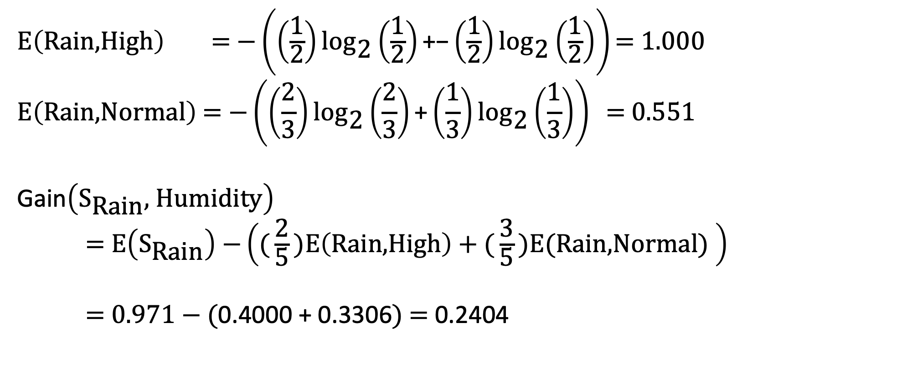
Question 1 – Humidity Entropy given Rain
$\text{E}\left(\text{Rain}\text{,}\text{High}\right)\text{ = −}\left(\left(\frac{\text{1}}{\text{2}}\right){\text{log}}_{\text{2}}\left(\frac{\text{1}}{\text{2}}\right)\text{+}\text{−}\left(\frac{\text{1}}{\text{2}}\right){\text{log}}_{\text{2}}\left(\frac{\text{1}}{\text{2}}\right)\right)\text{= 1.000 }$
$$\text{E}\left(\text{Rain}\text{,}\text{Normal}\right) \text{=} \text{−}\left(\left(\frac{\text{2}}{\text{3}}\right){\text{log}}_{\text{2}}\left(\frac{\text{2}}{\text{3}}\right)\text{+}\left(\frac{\text{1}}{\text{3}}\right){\text{log}}_{\text{2}}\left(\frac{\text{1}}{\text{3}}\right)\right) \text{=}\text{ 0.551}$$
Gain$\left({\text{S}}_{\text{Rain}}\text{, }\text{Humidity}\right)$
$\text{=} \text{E}\left({\text{S}}_{\text{Rain}}\right) \text{−}\left(\text{(}\frac{\text{2}}{\text{5}}\text{)}\text{E}\left(\text{Rain}\text{,}\text{High}\right)\text{ + (}\frac{\text{3}}{\text{5}}\text{)}\text{E}\text{(}\text{Rain}\text{,}\text{Normal}\text{) }\right)$
$\text{=}\text{ 0.971 }\text{−}\text{ (}\text{0.}\text{4000 + }\text{0.3306}\text{)}\text{ = }\text{0.2404}$

Slide 34
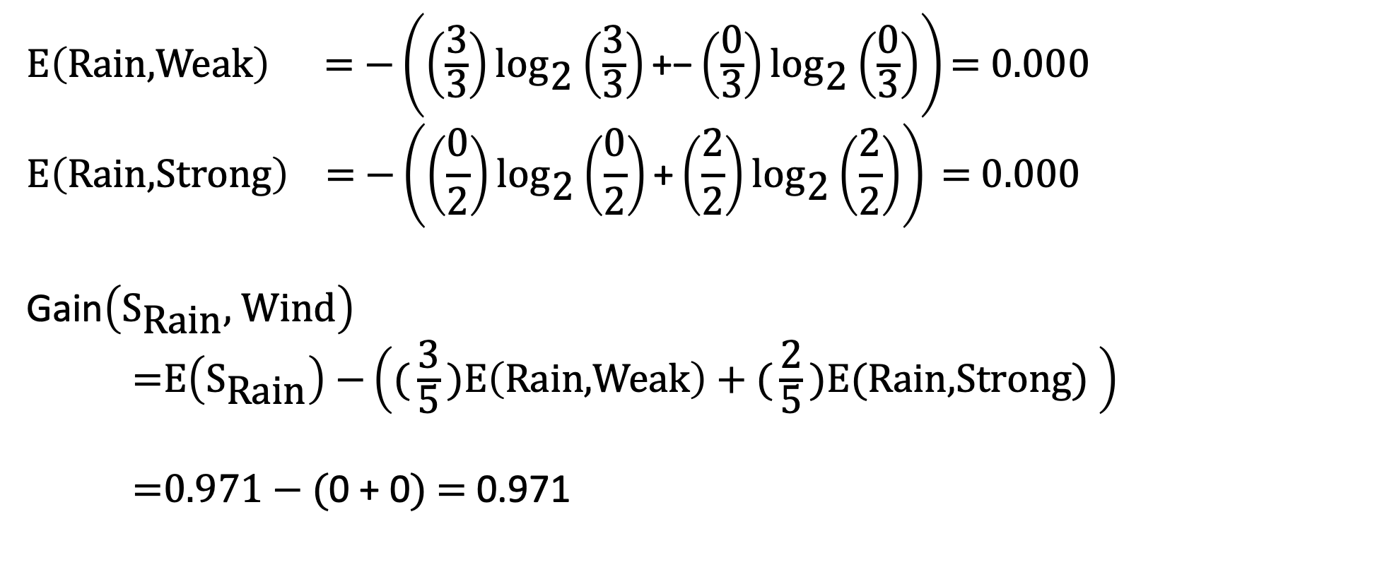
Question 1 – Wind Entropy given Rain
$\text{E}\left(\text{Rain}\text{,}\text{Weak}\right)\text{ = −}\left(\left(\frac{\text{3}}{\text{3}}\right){\text{log}}_{\text{2}}\left(\frac{\text{3}}{\text{3}}\right)\text{+}\text{−}\left(\frac{\text{0}}{\text{3}}\right){\text{log}}_{\text{2}}\left(\frac{\text{0}}{\text{3}}\right)\right)\text{= 0.000 }$
$$\text{E}\left(\text{Rain}\text{,}\text{Strong}\right) \text{=} \text{−}\left(\left(\frac{\text{0}}{\text{2}}\right){\text{log}}_{\text{2}}\left(\frac{\text{0}}{\text{2}}\right)\text{+}\left(\frac{\text{2}}{\text{2}}\right){\text{log}}_{\text{2}}\left(\frac{\text{2}}{\text{2}}\right)\right) \text{=}\text{ 0.000}$$
Gain$\left({\text{S}}_{\text{Rain}}\text{, }\text{Wind}\right)$
$\text{=}\text{E}\left({\text{S}}_{\text{Rain}}\right) \text{−}\left(\text{(}\frac{\text{3}}{\text{5}}\text{)}\text{E}\left(\text{Rain}\text{,}\text{Weak}\right)\text{ + (}\frac{\text{2}}{\text{5}}\text{)}\text{E}\text{(}\text{Rain}\text{,}\text{Strong}\text{) }\right)$
$\text{=}\text{0.971 }\text{−}\text{ (}\text{0}\text{ + }\text{0}\text{)}\text{ = }\text{0.971}$

Slide 35
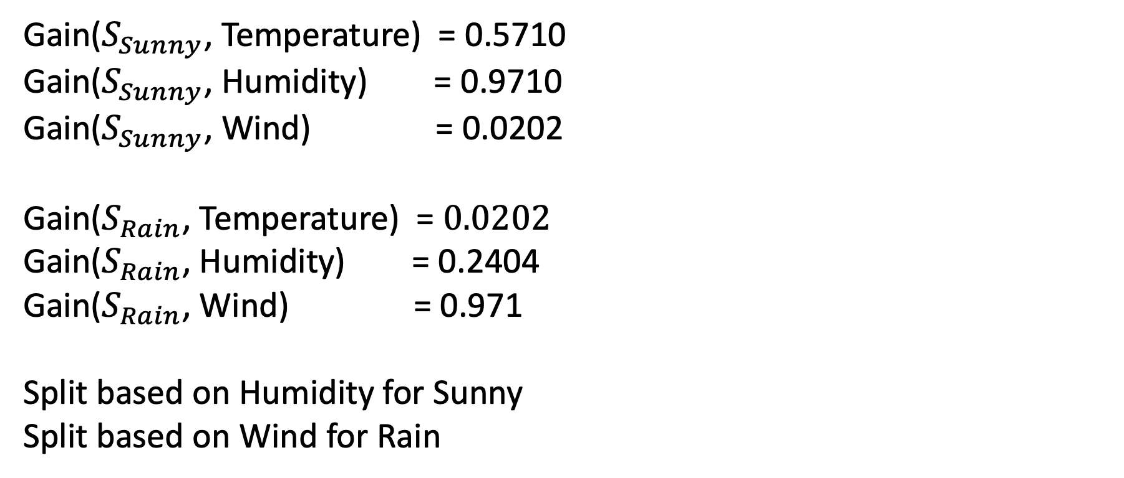
Question 1 – Second Feature Selection Gains
Gain($S_{Sunny}$, Temperature) = $\text{0.571}$0
Gain($S_{Sunny}$, Humidity) = $\text{0.9710}$
Gain($S_{Sunny}$, Wind) = $\text{0.0202}$
Gain($S_{Rain}$, Temperature) = $0.0202$
Gain($S_{Rain}$, Humidity) =$\text{0.2404}$
Gain($S_{Rain}$, Wind) =$\text{0.971}$
Split based on Humidity for Sunny
Split based on Wind for Rain

Slide 36
Question 1 – Second Feature Selection Gains
No other splits are required since the entropy at the current splits is 0.
This means that no bits are required to represent the information since there is only one answer.

Slide 37
Question 1 – Final Decision Tree
Outlook
Sunny
Rain
Overcast
Humidity
Yes
Wind
Normal
High
Weak
Strong
Yes
No
Yes
No

Slide 38
Question 1 – Final Decision Tree
Outlook
Sunny
Rain
Overcast
Humidity
Yes
Wind
Normal
High
Weak
Strong
1
0
1
0

Slide 39
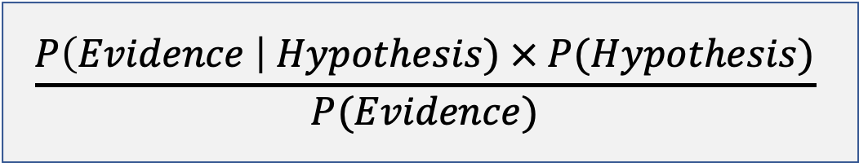
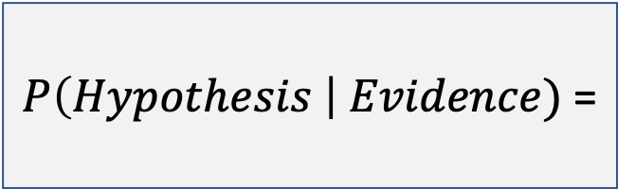
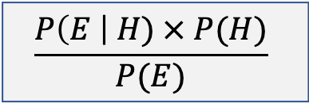

Bayes Theorem - Recap
$P\left(H \right| E)$ =
$$\frac{P\left(E \right| H) × P(H)}{P(E)}$$
Probability of a given event occurring based on our prior knowledge or evidence
$P\left(Hypothesis \right| Evidence)$ =
$$\frac{P\left(Evidence \right| Hypothesis) × P(Hypothesis)}{P(Evidence)}$$

Slide 40

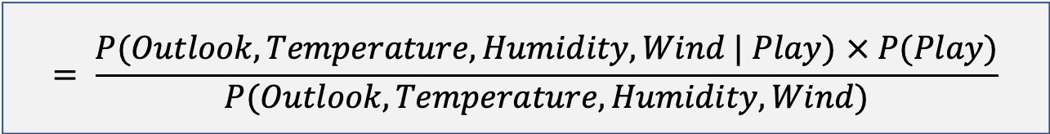

Question 2 – Bayes Classifier
$P\left(H \right| E)$ =
$$\frac{P\left(E \right| H) × P(H)}{P(E)}$$
$$P\left(Play \right| Outlook, Temperature, Humidity, Wind)$$
$$= \frac{P(Outlook, Temperature, Humidity, Wind | Play) × P(Play)}{P(Outlook, Temperature, Humidity, Wind)}$$
$$= \frac{P(Sunny, Hot, High, Weak | Play) × P(Play)}{P(Sunny, Hot, High, Weak)}$$
$$= \frac{P(Sunny, Hot, High, Weak |¬Play) × P(¬Play)}{P(Sunny, Hot, High, Weak)}$$

Slide 41





Question 2 – Bayes Classifier
$P\left(H \right| E)$ =
$$\frac{P\left(E \right| H) × P(H)}{P(E)}$$
Independent
$$Temperature$$
$$Wind$$
$$Outlook$$
$$Humidity$$
$$Play$$

Slide 42
Question 2 – Bayes Classifier
$P\left(H \right| E)$ =
$$\frac{P\left(E \right| H) × P(H)}{P(E)}$$
$$P(Sunny, Hot, High, Weak | Play) × P(Play)$$
$$P(Sunny | Play) × P(Hot\left| Play\right) × P(High| Play) × P(Weak\left| Play\right) × P(Play)$$
$$=\frac{2}{9} × \frac{2}{9} × \frac{3}{9} × \frac{6}{9} × \frac{9}{14}=0.00705$$

Slide 43
Question 2 – Bayes Classifier
$P\left(H \right| E)$ =
$$\frac{P\left(E \right| H) × P(H)}{P(E)}$$
$$P(Sunny, Hot, High, Weak |¬Play) × P(¬Play)$$
$$P(Sunny |¬Play) × P(Hot\left|¬Play\right) × P(High|¬Play) × P(Weak\left|¬Play\right) × P(¬Play)$$
$$=\frac{3}{5} × \frac{2}{5} × \frac{4}{5} × \frac{2}{5} × \frac{5}{14}=0.02743$$

Slide 44
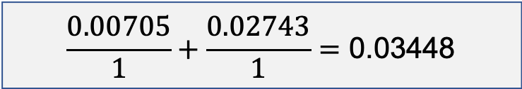
Question 2 – Bayes Classifier
$P\left(H \right| E)$ =
$$\frac{P\left(E \right| H) × P(H)}{P(E)}$$
$$\frac{0.00705}{1}+\frac{0.02743}{1}=\text{0.03448}$$
No

Slide 45
Notes
Assignment 2 packages are as follows:
Preprocessing toolkit:
https://www.nltk.org/
Modelling toolkit
https://scikit-learn.org/stable/

